Slide 1
Speedrunning like hacking
Roman Astrakhantsev

Slide 2
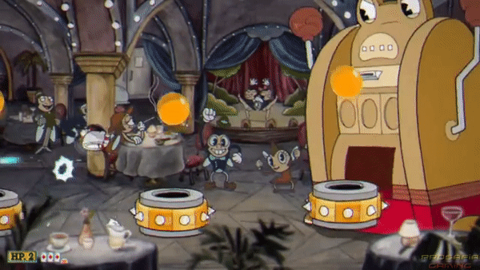
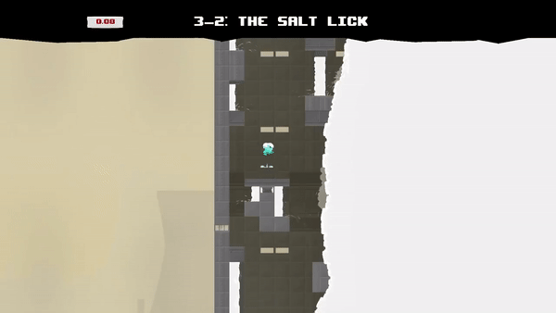

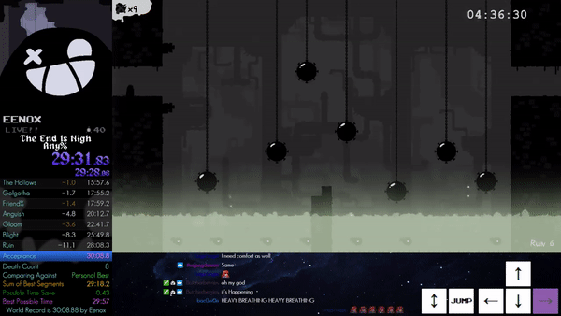
What is speedrunning

Slide 3
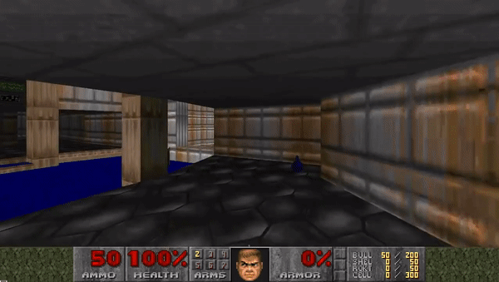
Doom. 8 sec

Slide 4
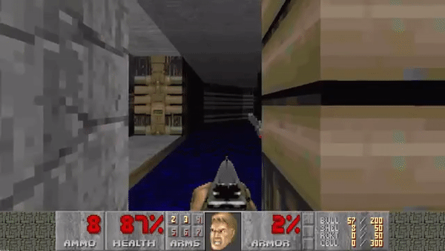
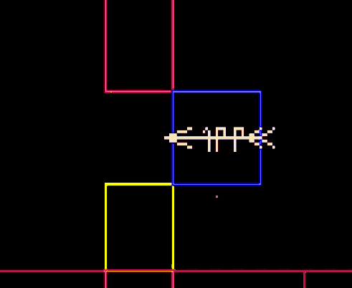
Doom. Squeeze Glide

Slide 5
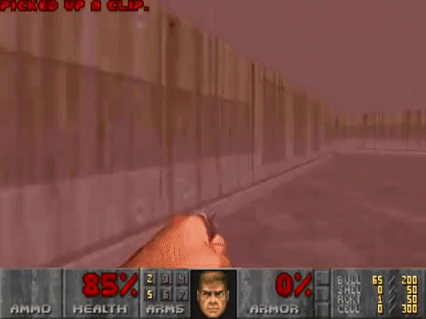

Doom. VOID GLIDE

Slide 6

Terraria. Items duplication

Slide 7
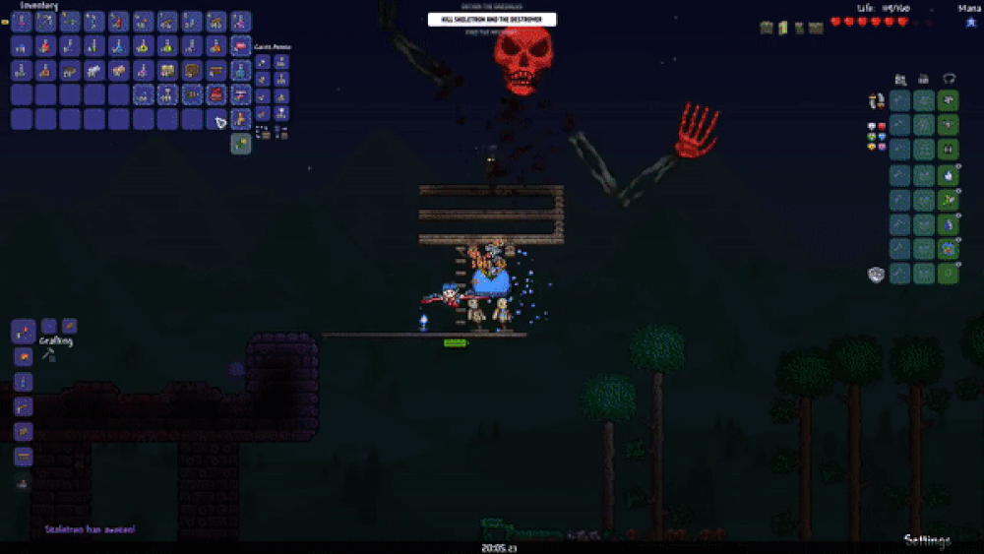
Terraria. Immortality

Slide 8
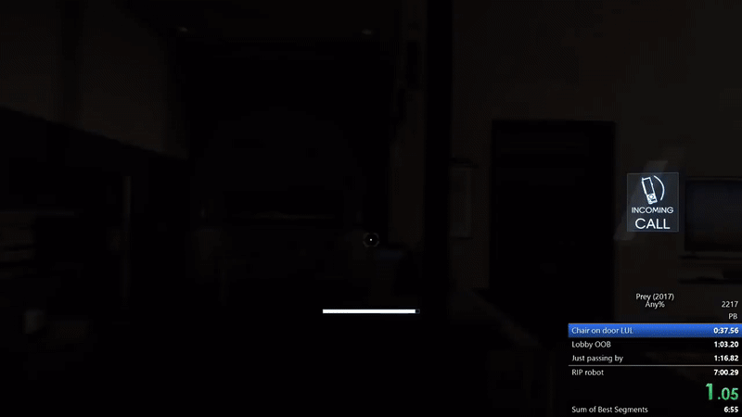
What about 3d?

Slide 9
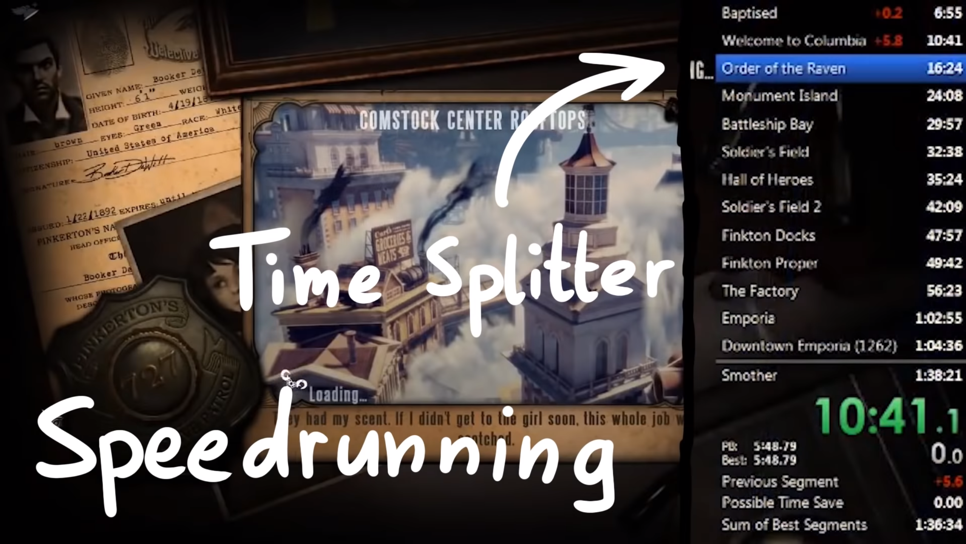
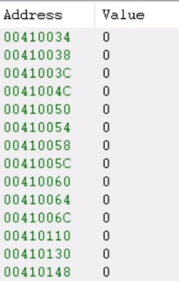
Speedrunning tools like cheats

Slide 10
Thank you for your attention
Play more games!

